Slide 1

Team: The Shiners
MSUClassIC
MSU Class Inventory Catalog
Team Iteration Leader:
Marcos Lopez
Samuel Olatunde
Athul Sajikumar
Notes:
MSUClassiC will be a scheduling app for MSUTexas. Our platform is made to simplify scheduling for Registrars, College Deans, and Department Chairs at Midwestern State University.
Users need to schedule every semester at MSUTexas, and this requires them to place a professor, class, and room at a specified time. This process is currently tedious and frustrating for many of the users.
Users shouldn’t have to deal with messy paperwork anymore. Our app will let them ask for room changes right there, avoiding manual updates and paperwork hassles. Whether it's the start of a new semester or just to make modifications to the existing schedules, our app has customizable options to fit every need.
With different views by building, department, and classrooms, it's simple to see what's available and make smart choices.

Slide 2
The Current Business Situation
Each semester, department chairs need to schedule their faculty to allow full coverage of their courses.
This scheduling is vital to an academic institution’s mission, as it allows students to make plans for their future education.
Existing solutions in the market often prioritize complex functionality and are monetized heavily

Slide 3
Business Goals
Provide a path for academic Chairs to ease their work flow during scheduling, making the overall process quicker
Allow for flexibility to change courses, locations, time, and faculty for a course with minimal hassle.
Provide a path for deans and registrar staff to be able to quickly evaluate a schedule

Slide 4
Application Wish List (up to 4 slides)
A web application for academic scheduling for every semester
Drag and Drop Interactivity: A user should be able to easily drag and drop an item on the schedule in order to make a change to it.
Excel import/export: A user should be able to upload a previous semester as a starting place for their schedules, and export an excel file for their updated
Easier user interface : The user interface should be simpler and easier to navigate

Slide 5
Identifying Needs - General
Users should be able to log in from the homepage.
It should be a web-based application.
Navigation should be simplified and not overcrowded.
Registrars, deans, and chairs should have access to their respective views based on their roles.

Slide 6
Identifying Needs - Registrar/Dean Dense
There should be a menu for requesting or approving requests based on the user's role.
Users should be able to submit requests via a form and provide appropriate details for later compilation by the registrar.
The Registrar should have the authority to approve or deny requests based on conflicts.
Only the registrar should have permission to make changes to the database.
Deans and chairs should have the ability to view the database.

Slide 7
Identifying Needs - Chair
Ability to import Excel files.
Access to view professors versus courses.
Access to view classrooms versus times.
Access to view professors versus times.

Slide 8
Identifying Needs - Chair (cont’d)
Access to view courses versus times.
Capability to move courses into desired locations using drag-and-drop in each view.
Functionality to submit all changes back to the Excel sheet.

Slide 9
Functional Requirements

Slide 10
1.1 User Classes and Characteristics -
1.1.1 Chair’s Function (Present)
The system shall allow the Chair to log in and out.
The system shall enable the Chair to import Excel files.
The system shall provide the Chair with the ability to view Excel contents in pivot table views.
The system shall allow the Chair to view pivots such as professors vs. time, professors vs. courses, time vs. courses, rooms vs. courses, and rooms vs. time.
The system shall facilitate editing views with drag and drop for the Chair.
The system shall allow the Chair to submit changes to the database as requests.
The system shall enable the Chair to export database changes as Excel files.

Slide 11
1.1.2 Registrar's Functions
The system shall allow the Registrar to export the schedule to PDF or Excel.
The system shall provide the Registrar with the ability to approve or deny schedule changes.
The system shall automatically approve conflict-free courses for the Registrar.
The system shall allow the Registrar to manually approve conflicting courses.
The system shall enable the Registrar to view conflicts in the request queue.
The system shall allow the Registrar to view buildings by room and time, and by course and room.

Slide 12
1.1.3 Deans' Functions
All Deans shall be able to approve or deny schedule changes within their college.
All Deans shall automatically approve conflict-free courses within their college.
All Deans shall be able to manually approve conflicting courses within their college.
All Deans shall have the ability to view conflicts in the request queue within their college.
All Deans shall be able to view buildings by room and time, and by course and room within their college.

Slide 13
Nonfunctional Requirements

Slide 14
1.2.1 Operating Environment:
The system shall operate on the Windows/MacOS operating system.
The system shall use the MySQL database.
The system shall utilize the Vue.js web framework.
The system shall be implemented using the Python language.
The system shall employ frontend technologies including HTML, CSS, and JavaScript.
The system shall be accessible via a web browser.

Slide 15
1.2.1 Other Nonfunctional Requirements
Maintainability
The codebase shall be easy to maintain and update, featuring clear and well-documented code and design.
Compatibility:
The app shall be compatible with multiple devices and browsers.
Scalability:
The app shall support multiple users without performance degradation.

Slide 16
1.2.1 Other Nonfunctional Requirements (cont’d)
Ease of Use:
The interface shall be easy to navigate, with clear and concise instructions and user-friendly layouts. It shall not be crowded.
Support and Documentation:
MSUClassIC will be supported by the development team for at least 3 months after its initial release around end of April 2024.
A user manual will be available for users.

Slide 17
Design and Implementation Constraints:
Time to market
Must use a Database
End users shall be responsible for software maintenance.
Concurrent User Access

Slide 18
List of Information Techniques that you used to derive requirements
Stakeholder Survey
User Interviewing
Study of existing business procedures and forms

Slide 19
List of Information Techniques that you used to derive requirements
Stakeholder Survey
Asked department chairs and a dean about their experiences doing academic scheduling
Defined points of frustration within the process
Asked about important features that they would like to see
Asked about features that were not as vital

Slide 20
List of Information Techniques that you used to derive requirements
2. User Interviewing with use of questionnaire
Since the focus was placed more into the workflow the chairs, we continued interviewing department chairs about what they would like out of software
A questionnaire was developed to get consistent feedback among interviewees

Slide 21
List of Information Techniques that you used to derive requirements
3. Study of existing business procedures and forms
Users provided relevant documents to use as sample inputs
These documents (excel files) also helped solidify the workflow and type of data needed for the web application to interact with

Slide 22
What is the business, the current business situation, and how does it operate?
MSU Texas is a public liberal arts university. It provides a variety of educational, social, and community activities for Wichita Falls.
The current academic scheduling process is manual, involving tedious coordination among Registrars, College Deans, and Department Chairs.
It currently operations through direct communication and manual entry of scheduling preferences and requirements into a system rife with inefficiencies and conflicts.

Slide 23
What is the system’s environment or context?
The system operates within the academic affairs side of MSUTexas.
The scheduling system has many stakeholders including students, faculty, and staff.
The environment for this scheduling process is an intensive and stressful process for each department over the course of a 3-week period towards the beginning of each semester, when focus should be on students and course design

Slide 24
What are existing business processes, their input and output, and how do they relate to each other?
The registrar disperses the schedule as an excel file to each college, which distributes them to each department head.
The faculty use the input information including course offering, faculty schedules, classroom availability, and student enrollment projections to manually coordinate their department’s schedules.
They make changes to the excel file, which is sent back to the registrar for approval

Slide 25
What are the problems with the current system?
This method has a high susceptibility to human error, leading to scheduling conflicts
Inefficient and lengthy durations to visualize and set each department’s schedules
Frustration among a high stress and short environment to do the tedious scheduling task

Slide 26
What are the business or product goals?
Efficiency: Each department chair and dean interviewed want a more efficient system for scheduling
User-Friendliness: MSUTexas would like an easy-to-use interface that allows users to quickly make changes for their department’s schedules
Adaptability: The product should be able to display information in a variety of formats that helps the department chair see the relevant information dynamically

Slide 27
Who are the users of the current and future systems, respectively?
Users for the current system are Registrars, College Deans, and Department Chairs, as well as occasional administrative staff or delegated faculty
Users for the future system are Department Chairs, with College Deans and Registrars approving and overseeing the output without direct use of the system

Slide 28
What do the customer and users want, and what are their business priorities?
The main users of this system would be department chairs, who’s wants include:
An easy interactive view for their department scheduling
An adaptable scheduling system with real-time conflict resolutions
Less time spent on academic scheduling
MSUTexas as a customer want the academic semester to be scheduled without conflicts

Slide 29
What are the quality, performance,and security considerations?
Quality: The web application should be easy to use by the users, with intuitive functionality
Performance: If the web application takes too long to load or respond to requests, the user will be frustrated with the experience, and we will not have improved upon their work flow for academic scheduling
Security: Users should only be able to change courses and assignments within their department, and should not have the allowance to modify other department courses.

Slide 30
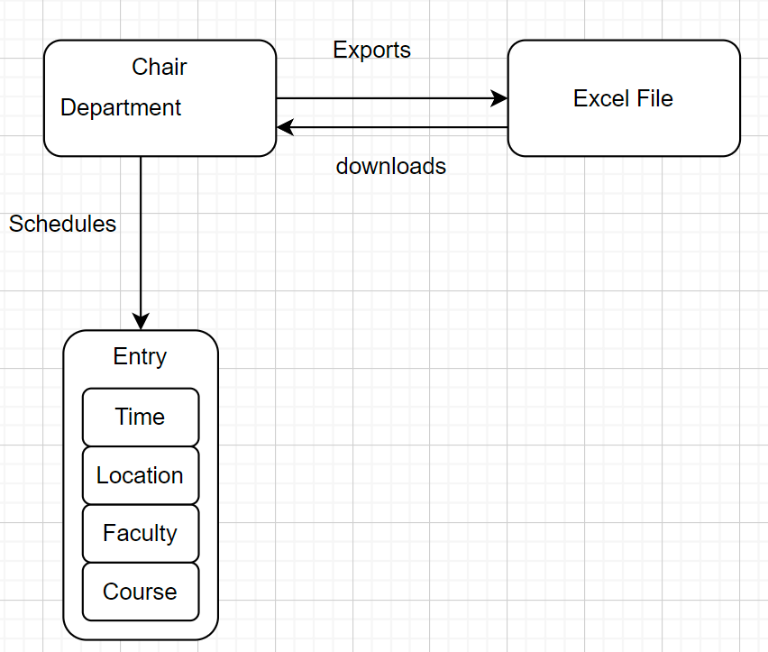
Business Domain
Our Domain is Education
The Entities are
The Department Chairs
The Course
The Times
The Classrooms
The Faculty

Slide 31
How did you collect information about your domain?
Interviewing customer representatives and users
Interviewed Dr. Mitchell, Interim Chair of Mathematics
Interviewed Dr. Stringfellow, Chair of Computer Science
Interviewed Dr. Cobb, Interim Dean of the McCoy College of Science, Math, and Engineering

Slide 32
How did you collect information about your domain?
Study of similar projects
Researched the current approach to scheduling at MSUTexas, which is to not use the currently provided software due it complexity (AdAstra)
Looked at other viable options for software that are not implemented at MSUTexas
Coursedog
Accruent EMS
CourseLeaf

Slide 33
Results from Brainstorming Process
The main bottleneck for the scheduling process is the tedious and manual ways in which each department chair must manage individual changes, and the wait times between individual correspondence between chairs.
There was a major need and want to simply visualize the process for each department in an streamlined fashion
A high level registrar or dean view was not a high priority for much of the process
A department chair is the main editor of the schedule, with quality oversight by deans and registrar after the fact

Slide 34
Classification of classes
User
Chair
View
Entry
Course
Time
Professor
Location
Database

Slide 35
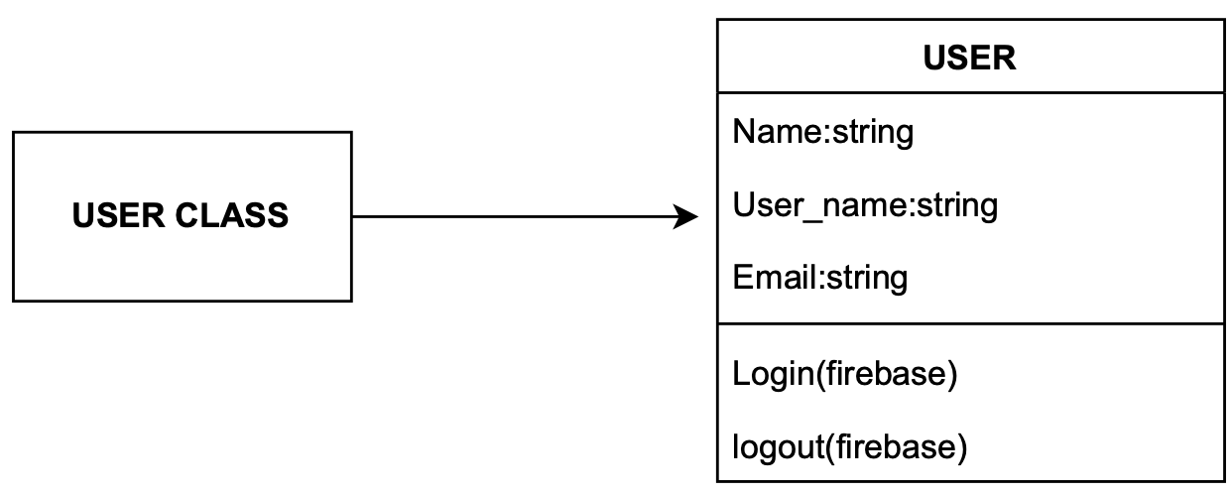
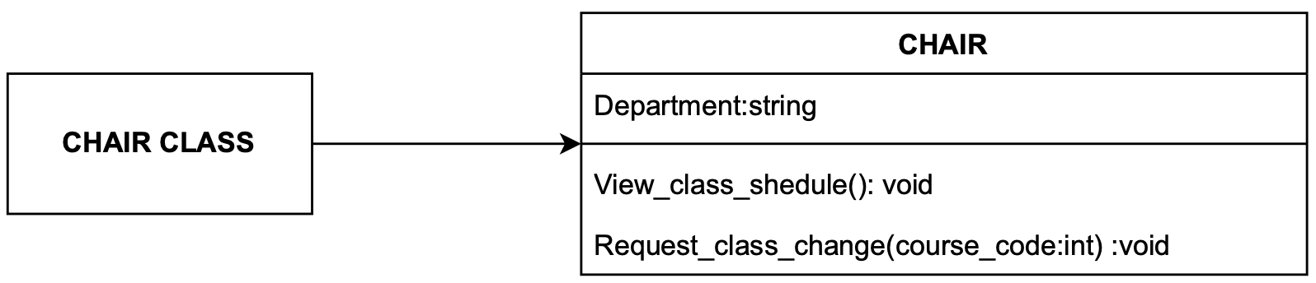
Classification of classes

Slide 36
Classification of classes

Slide 37
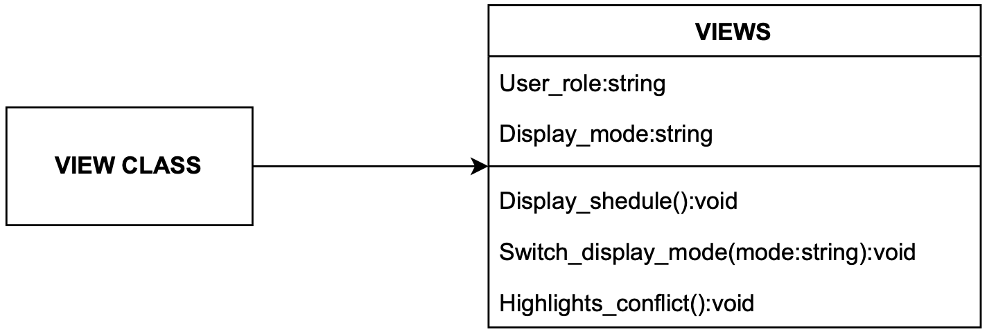
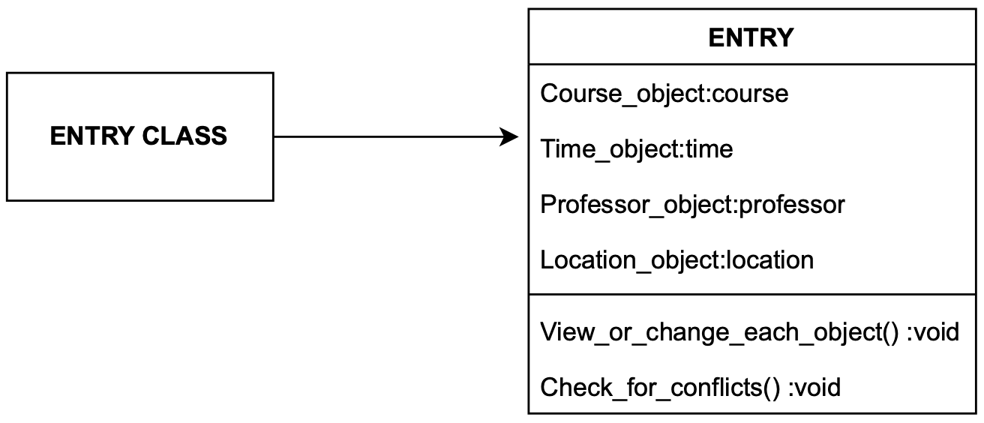
Classification of classes

Slide 38
Classification of classes

Slide 39
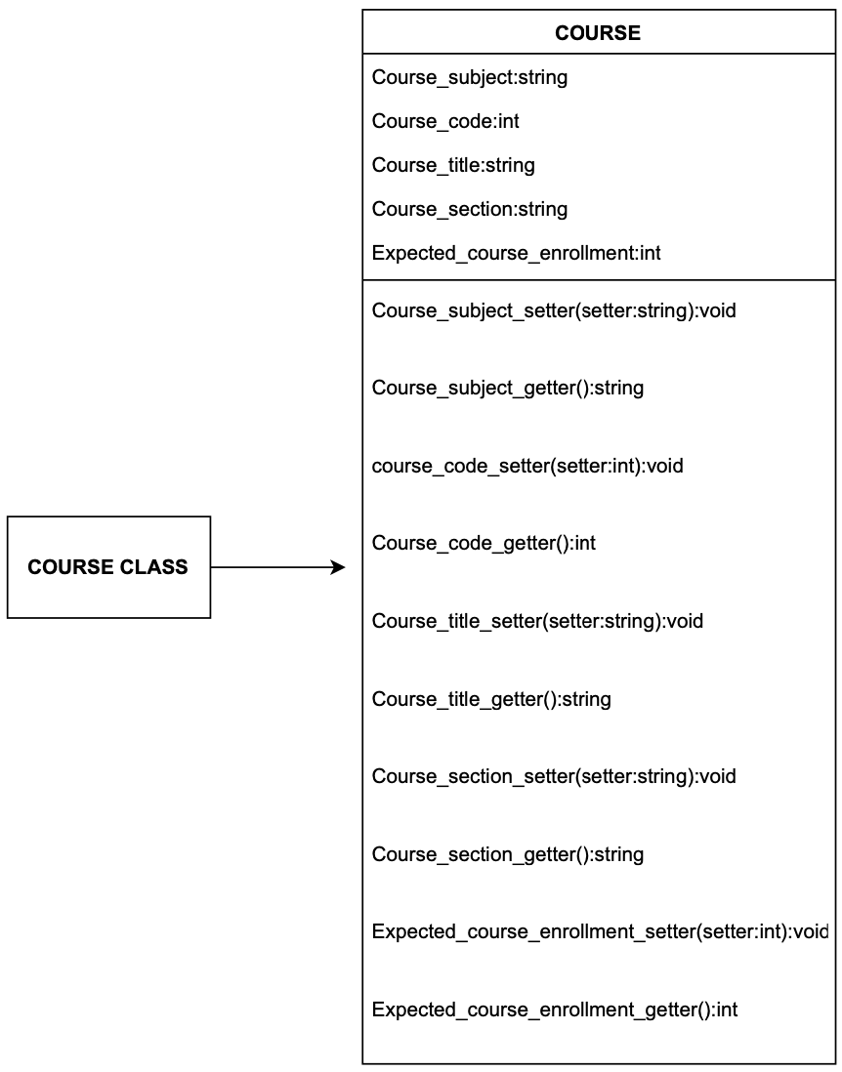
Classification of classes

Slide 40
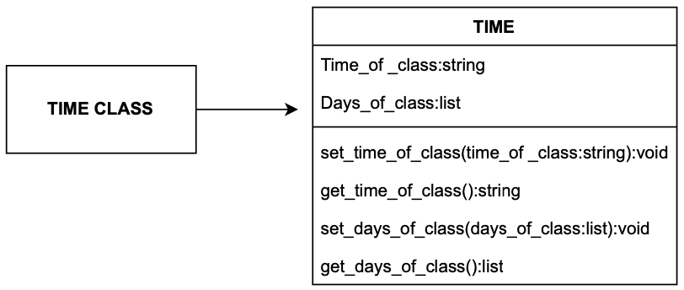
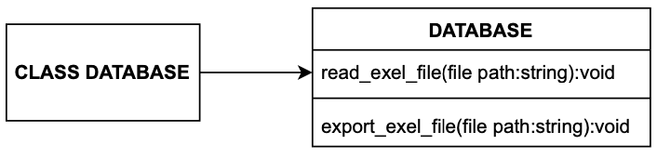
Classification of classes

Slide 41
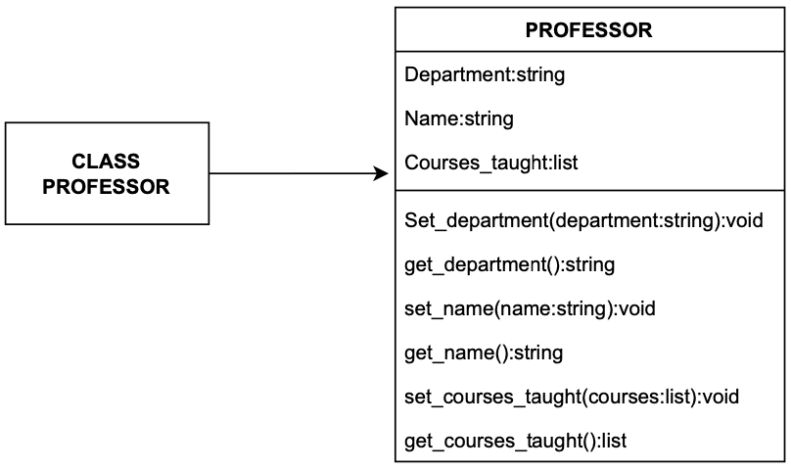
Classification of classes

Slide 42
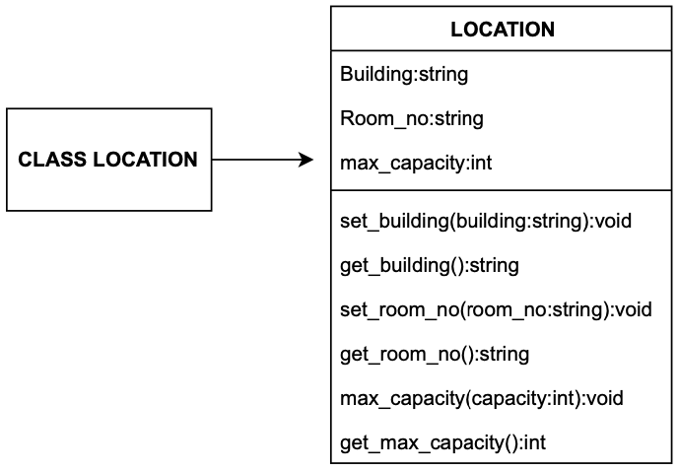
Classification of classes

Slide 43
Relationships
user and chair(chair is a subclass for a user)
location and entry
time and entry
course and entry
professor and entry
chair’s and views
views and entries
entries and database

Slide 44
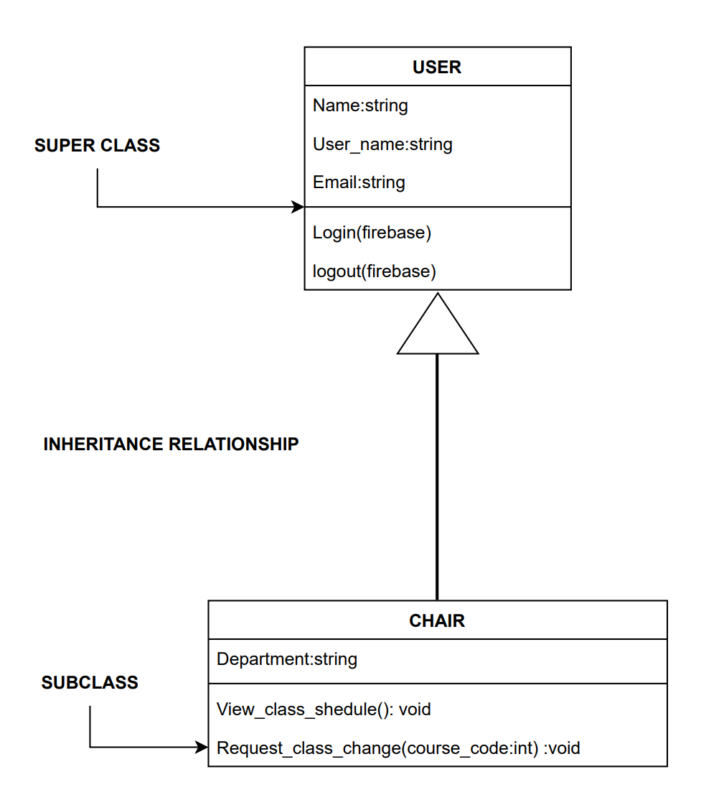
Relationships-
inheritance

Slide 45
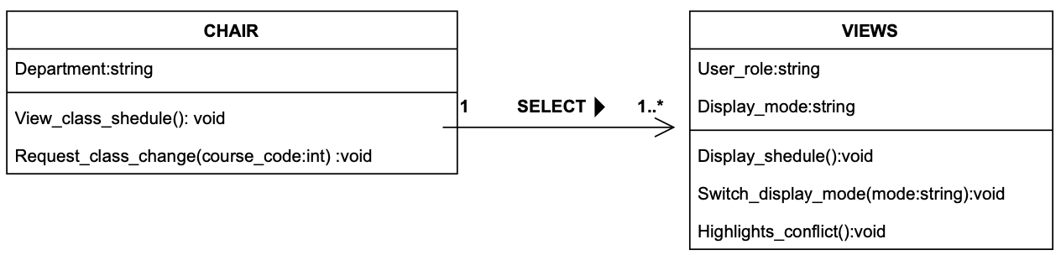
Relationships-Association
MULTIPLICITY
ASSOCIATION DIRECTION

Slide 46
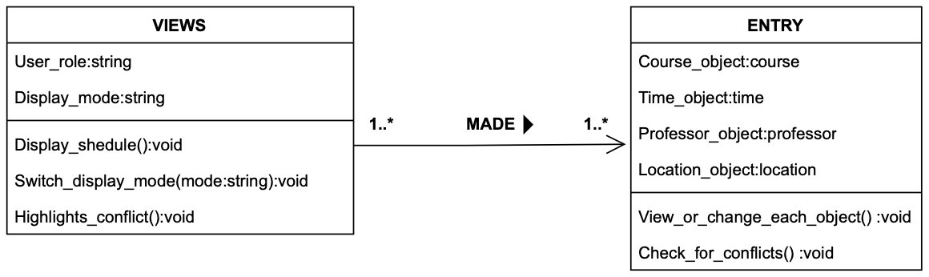
Relationships-Association
ASSOCIATION NAME

Slide 47
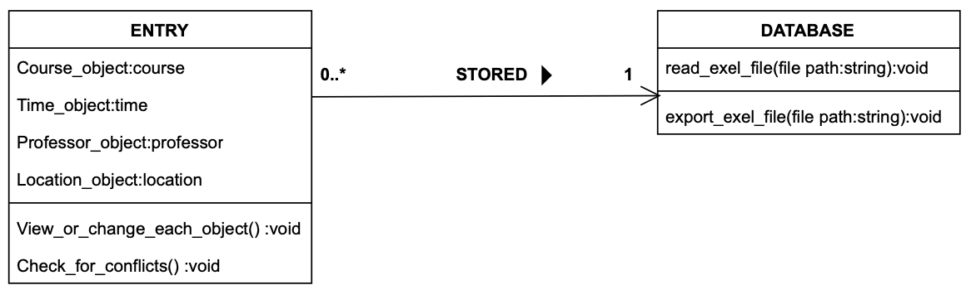
Relationships-Association

Slide 48
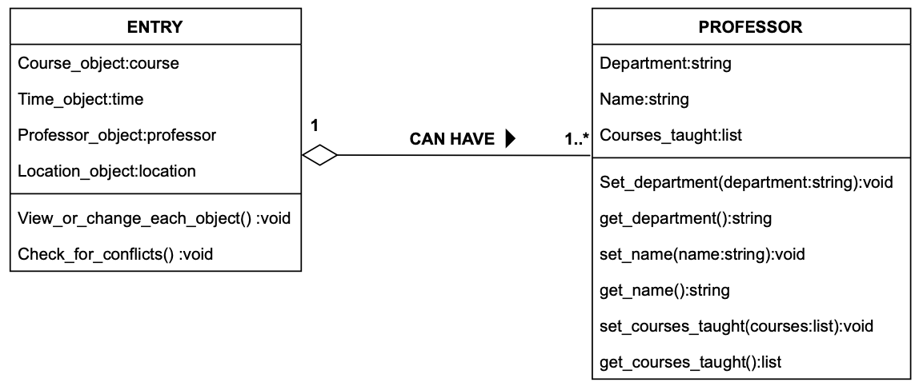
Relationships-Aggregation

Slide 49
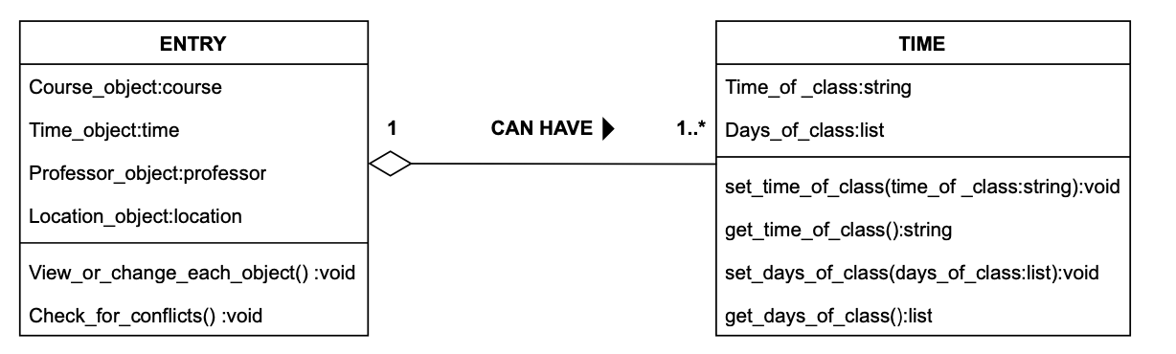
Relationships-Aggregation

Slide 50
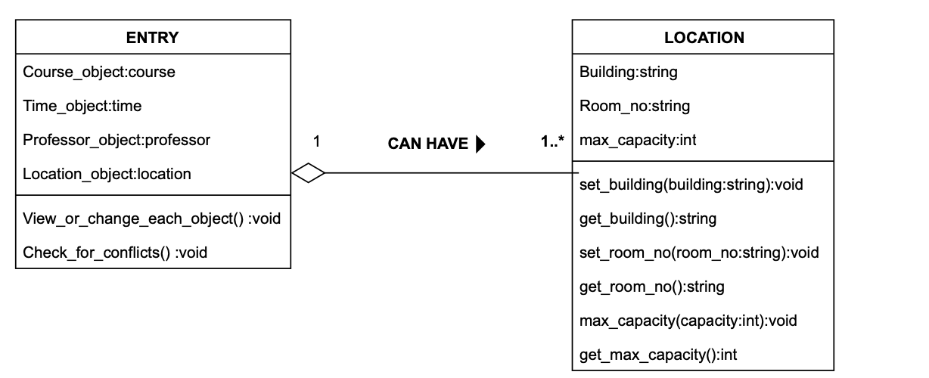
Relationships-Aggregation

Slide 51
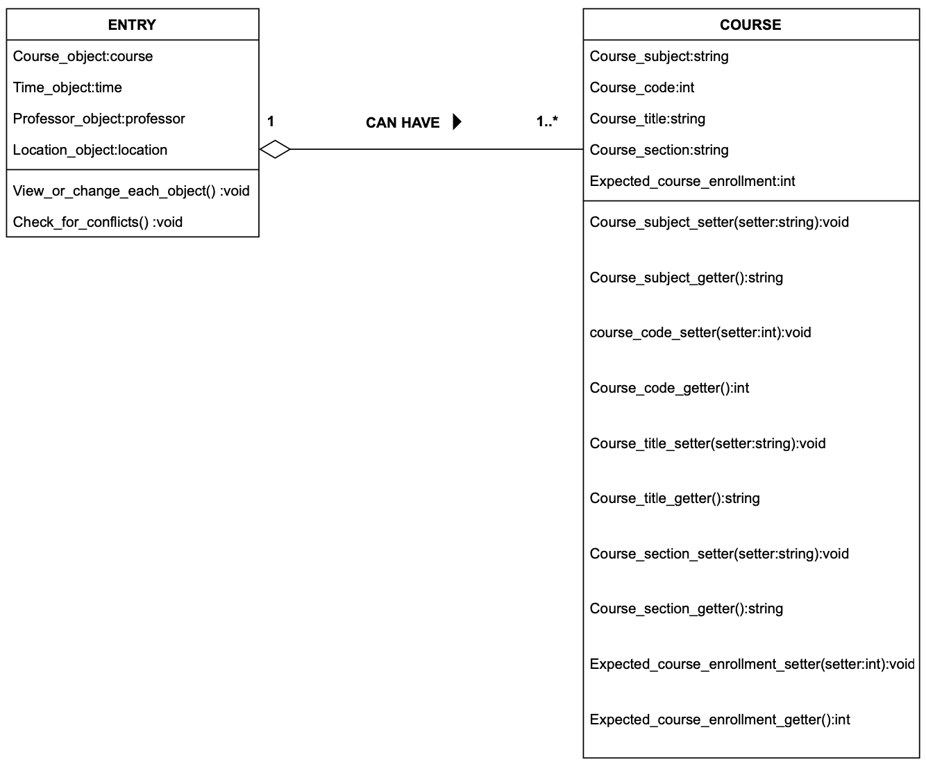
Relationships-
Aggregation

Slide 52
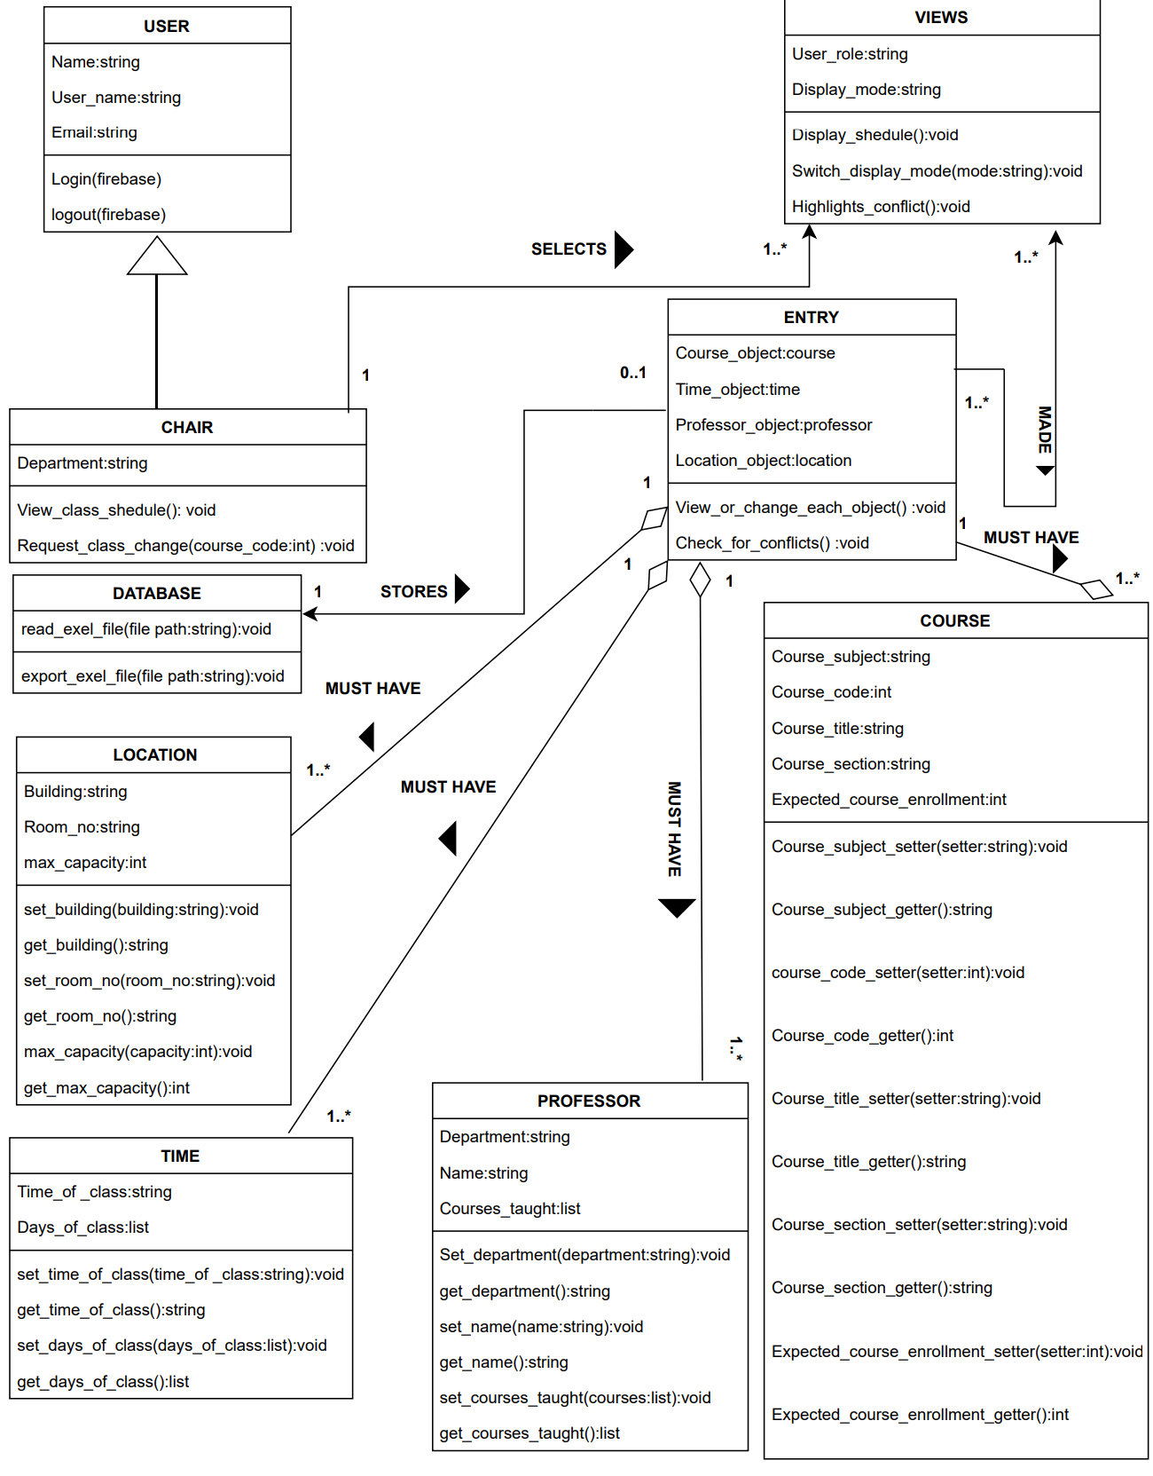
UML-Class Diagram

Slide 53
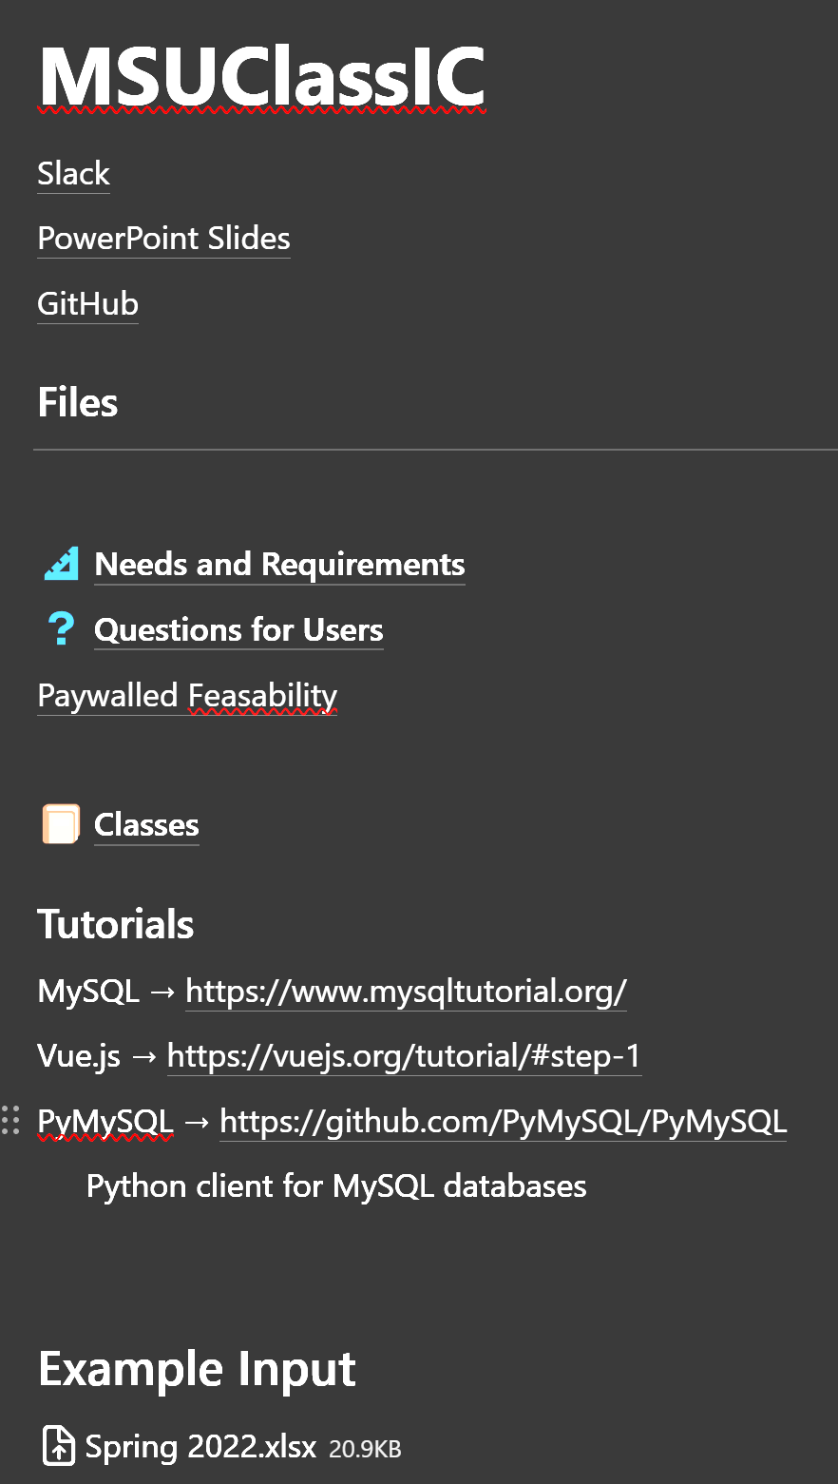
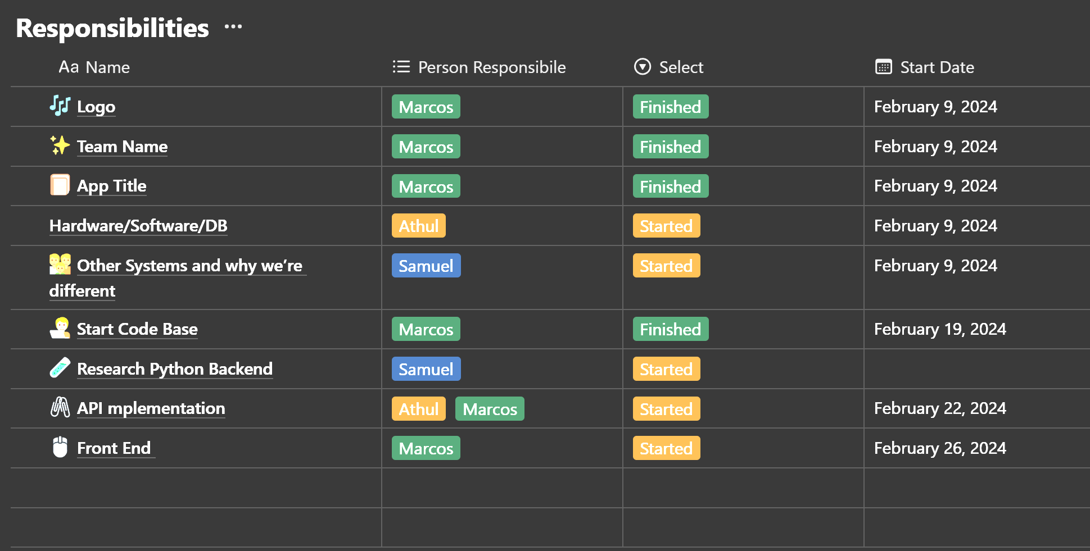
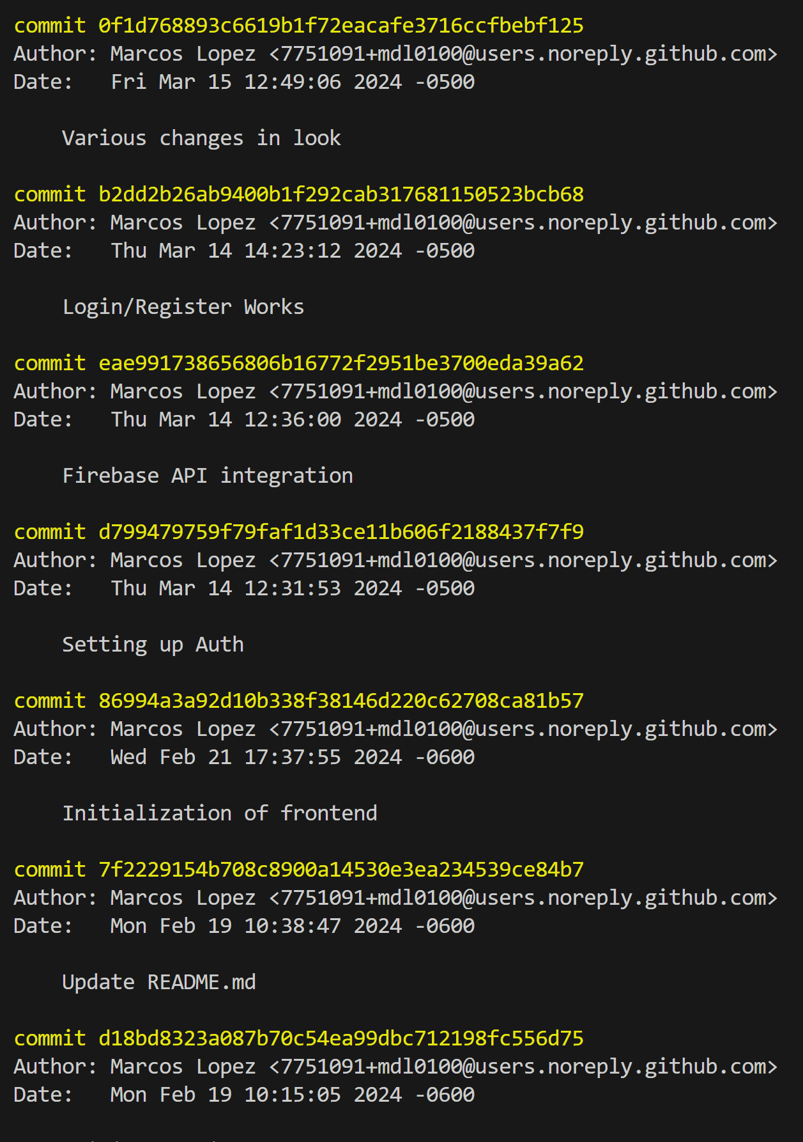
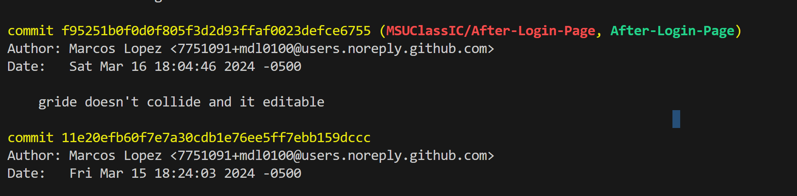
Proof of Version Control

Slide 54
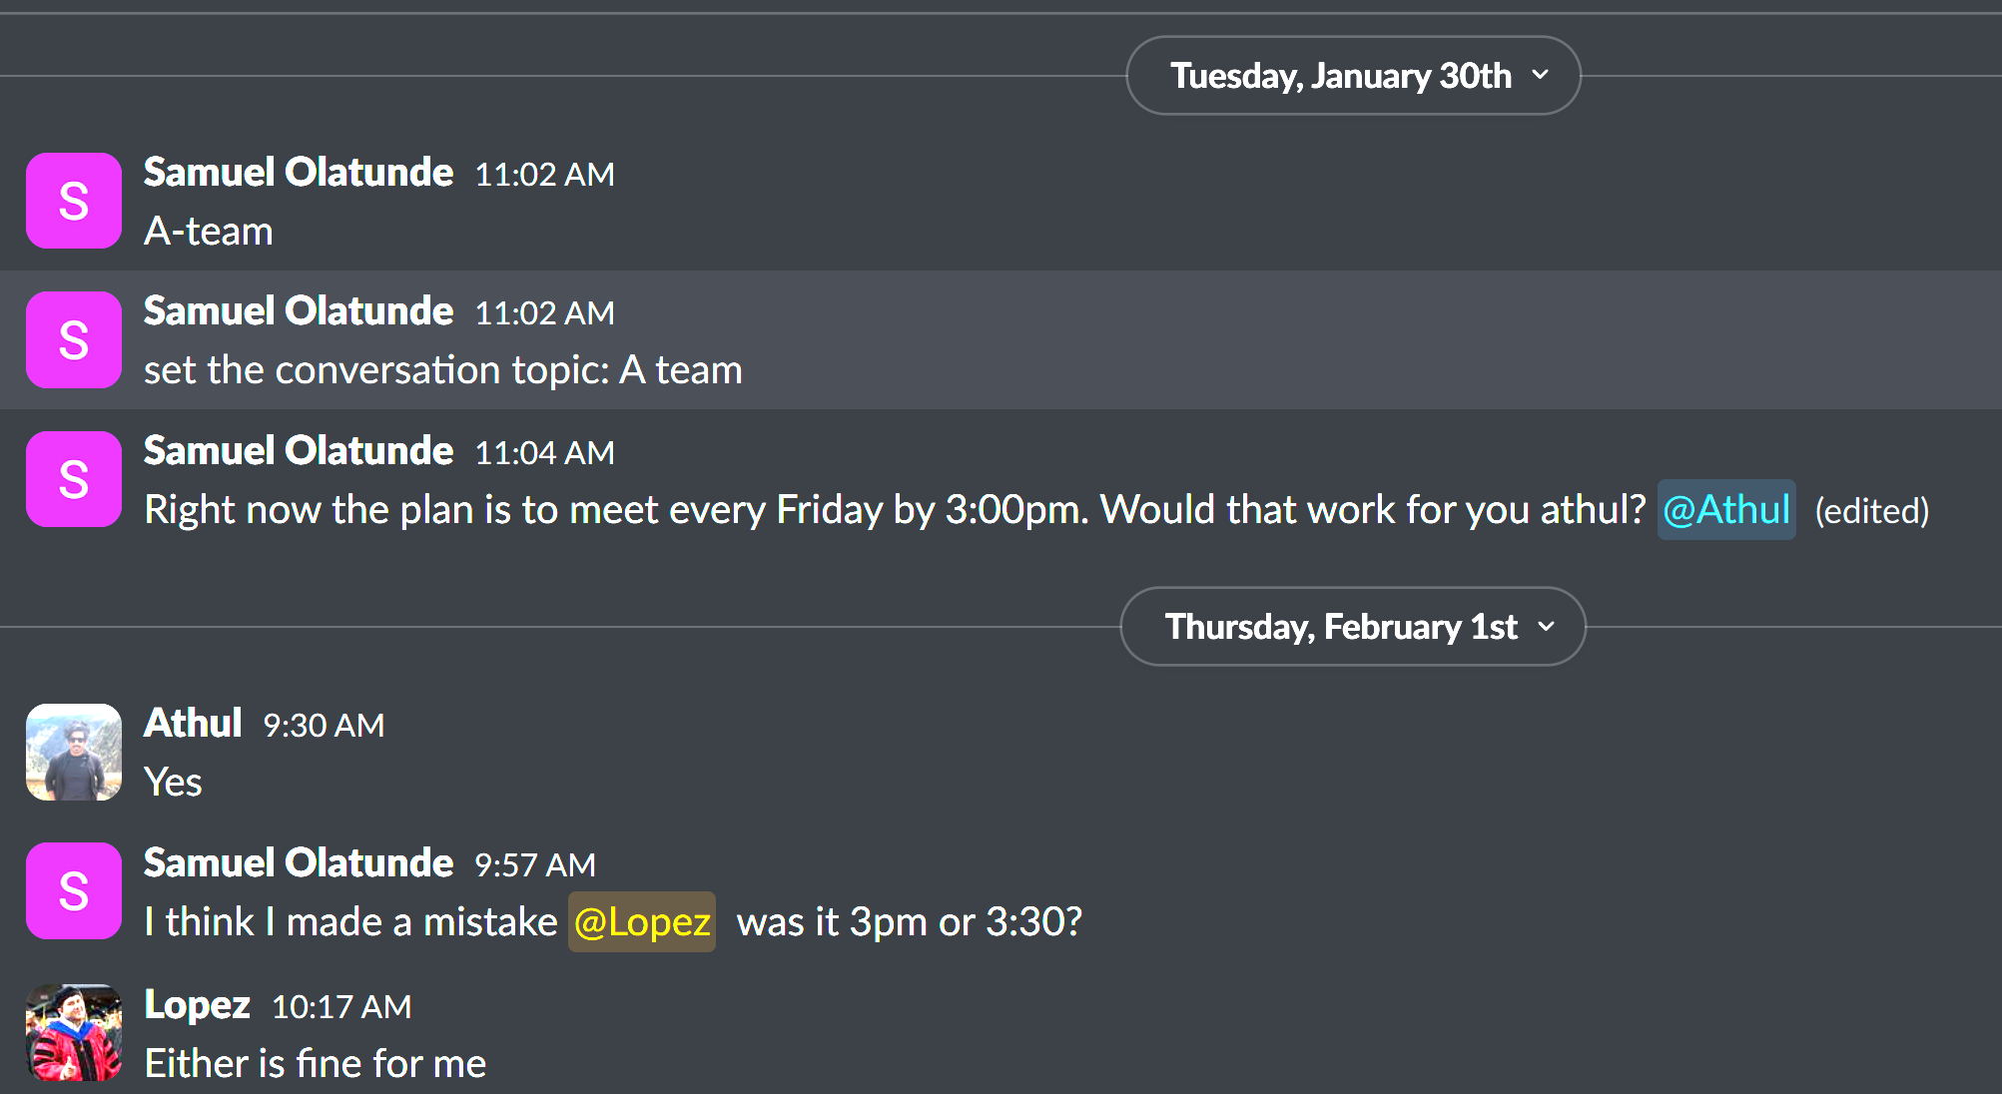
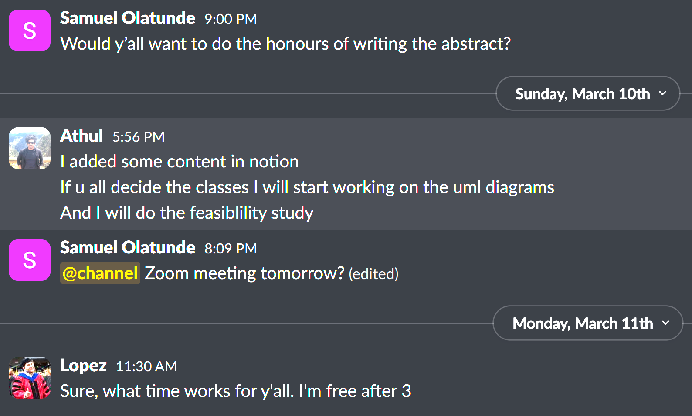
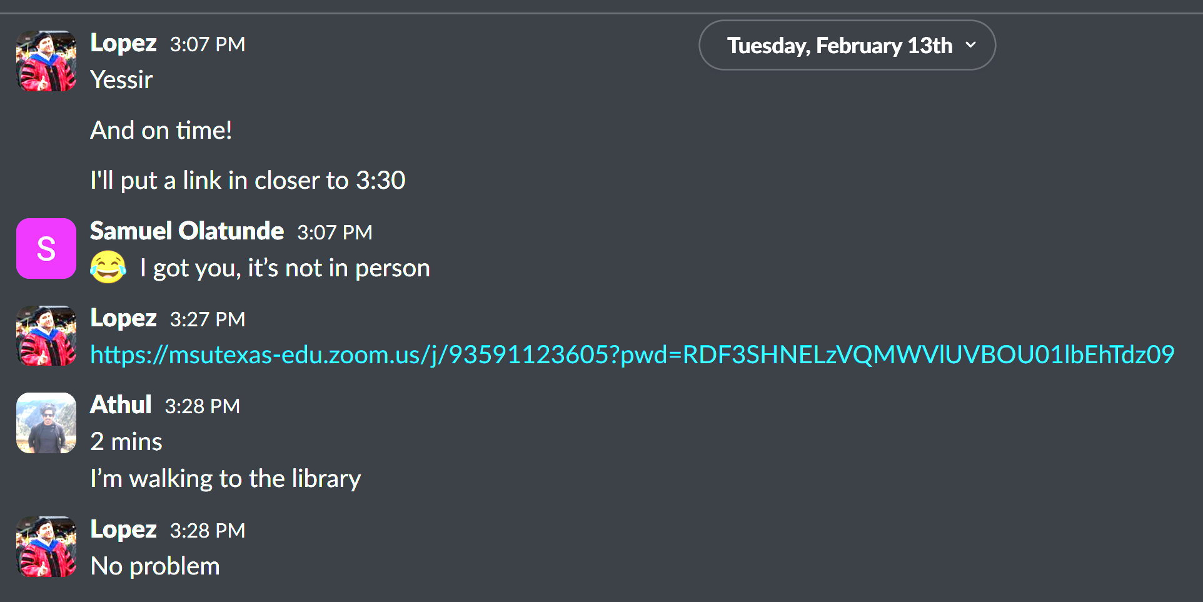
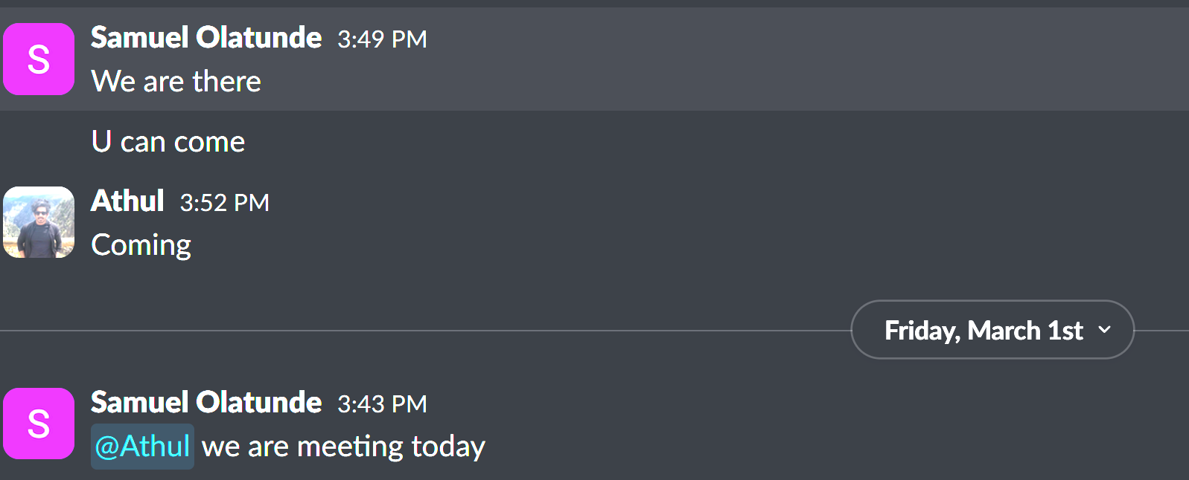
Proof of Team Communication

Slide 55
Team Member Work Accomplished
Athul
Feasibility Report
Software Requirements Specifications
Editing Slides
UML Diagrams
Classification of Classes
Domain Model

Slide 56
Team Member Work Accomplished
Marcos
Frontend development
Learning Vue.js
Coding
Firebase Implementation
Editing Slides
Editing documents
Interviewing users
Studying other systems
Video Production

Slide 57
Team Member Work Accomplished
Samuel
Editing Slides
Interviewing Users
Code generation from UML class diagrams

Slide 58
Schedule Update
Samuel
Develop Backend functionality
Make Excel files uploadable and exportable
Marcos
Continue Frontend development
Make views dynamic
API integration to connect frontend and backend
Athul
API integration to connect frontend and backend
Database Setup and Implementation

Slide 59
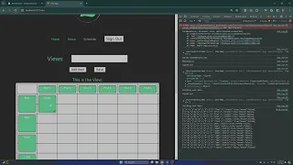
Project Demo
https://youtu.be/eDGgwmjaNtE

